Slide 1

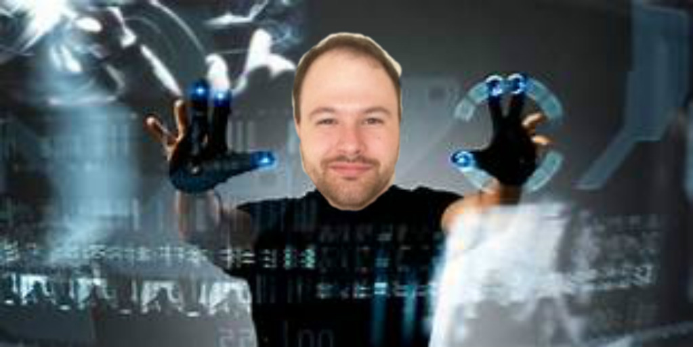
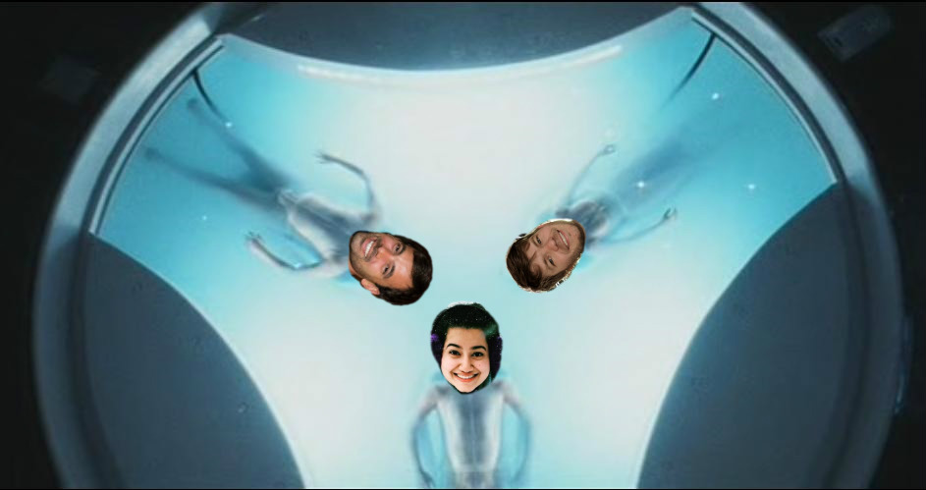
Starring:
Dr.Coop – Tom Cruise
Anika Rahman – PreCog 1
Andy Watson – PreCog2
David Shaffer – PreCog3

Slide 2
Mission:
Model and Predict Crime Demographics to save Dr.Coop’s life
Data Source:
Bureau of Justice Statistics API
https://www.bjs.gov/developer/index.cfm
Data collected by US Census Bureau
Surveys of victimized people and households in non-fatal incidents
Models and Tools Used:
Sci-Kit Learn
Keras
Random Forest
Pandas
MongoDB
Tableau

Slide 3
Data Points:
Personal Victimizations (~50,000 records spanning 1995-2017)
Age
Household Income
Injury
Location of Incident
Location of Residence
Marital Status
Population Size
Race
Region
Reported to the Police (Y or N)
Sex
Type of Crime
Victim Offender-Relationship
Weapon Category
Year
Data Source:
Bureau of Justice Statistics API
https://www.bjs.gov/developer/index.cfm
Data collected by US Census Bureau
Surveys of victimized people and households in non-fatal incidents
Models and Tools Used:
Sci-Kit Learn
Keras
Pandas
MongoDB
Tableau

Slide 4
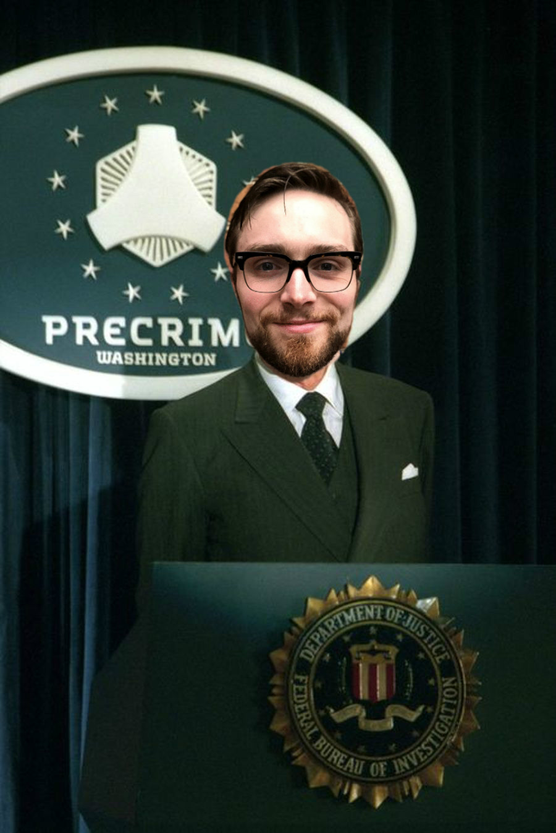
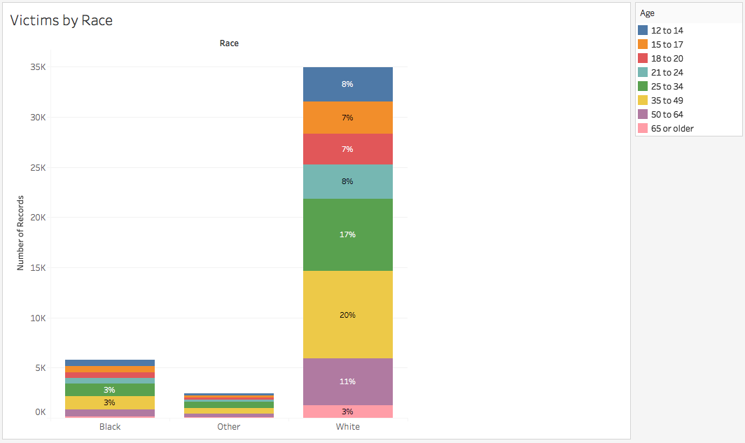
It appears we have a potential bias in our data from the Bureau of Justice

Slide 5
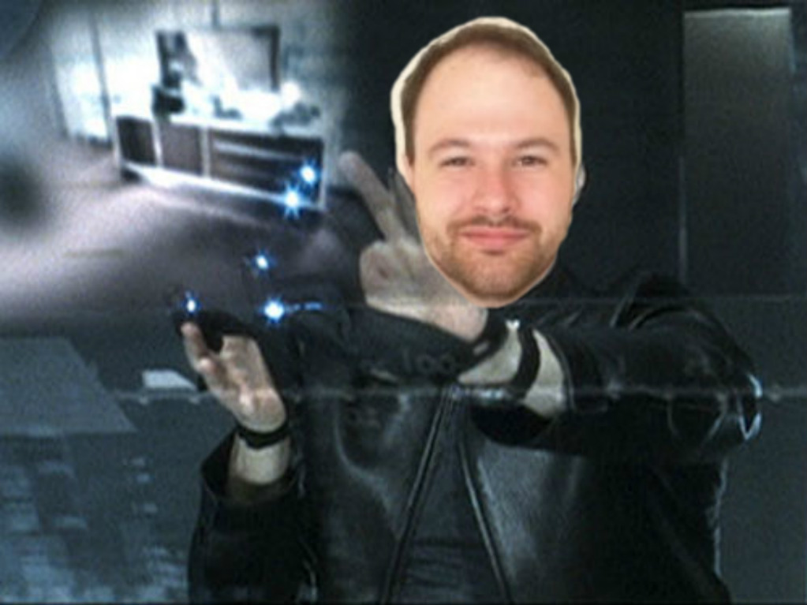
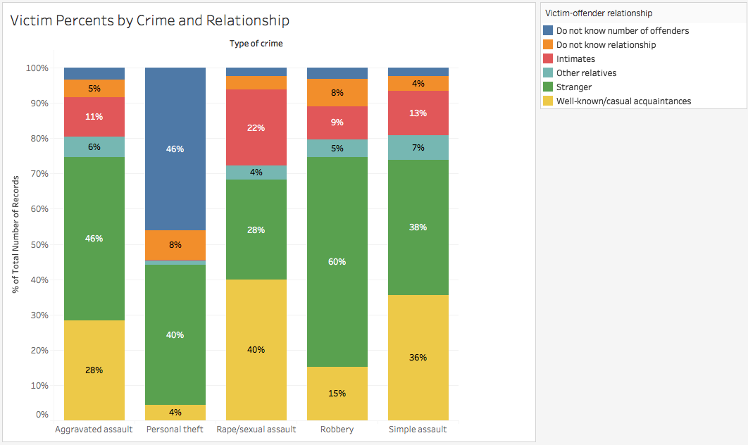
Victims know their offenders in some way in the majority of Assault crime… w/Sexual Assault having the largest majority at 66%

Slide 6
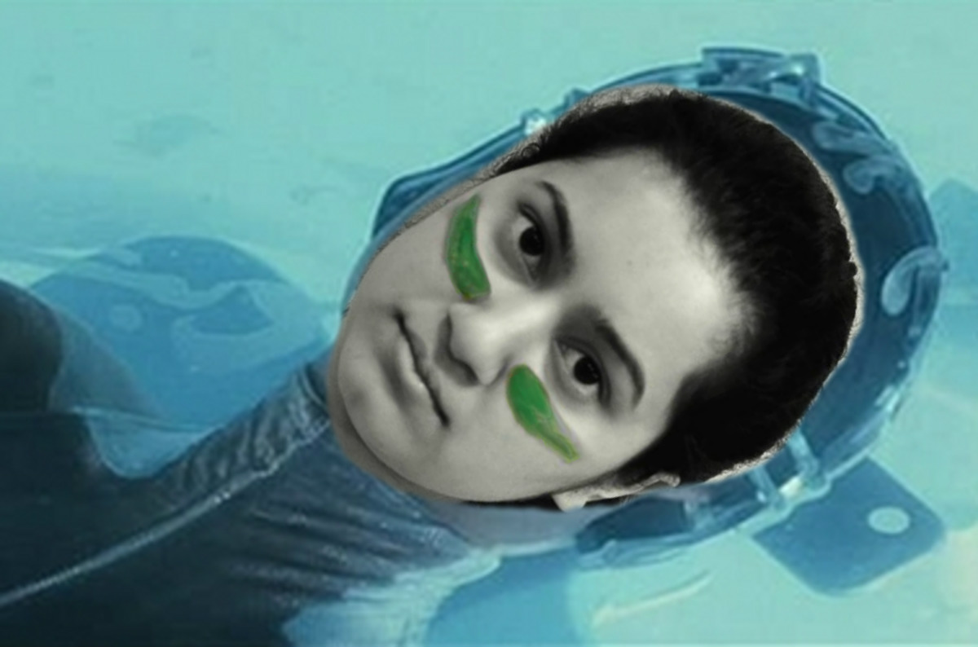
After running the Random Forest model and calculating feature importance, I’ve determined that…

Slide 7
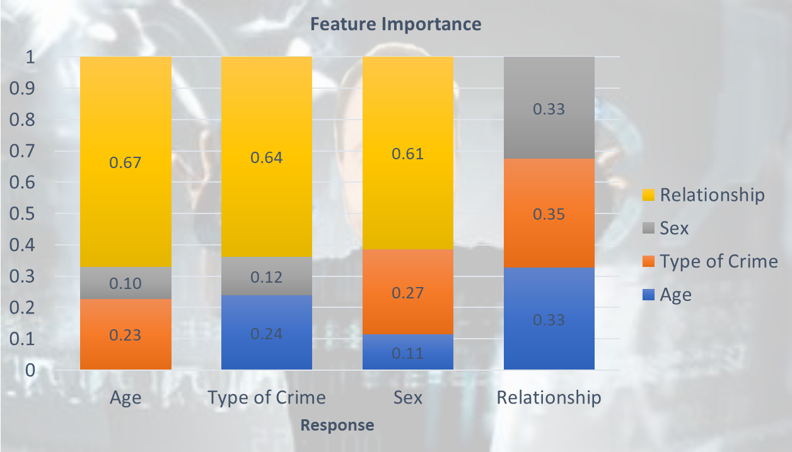

Slide 8
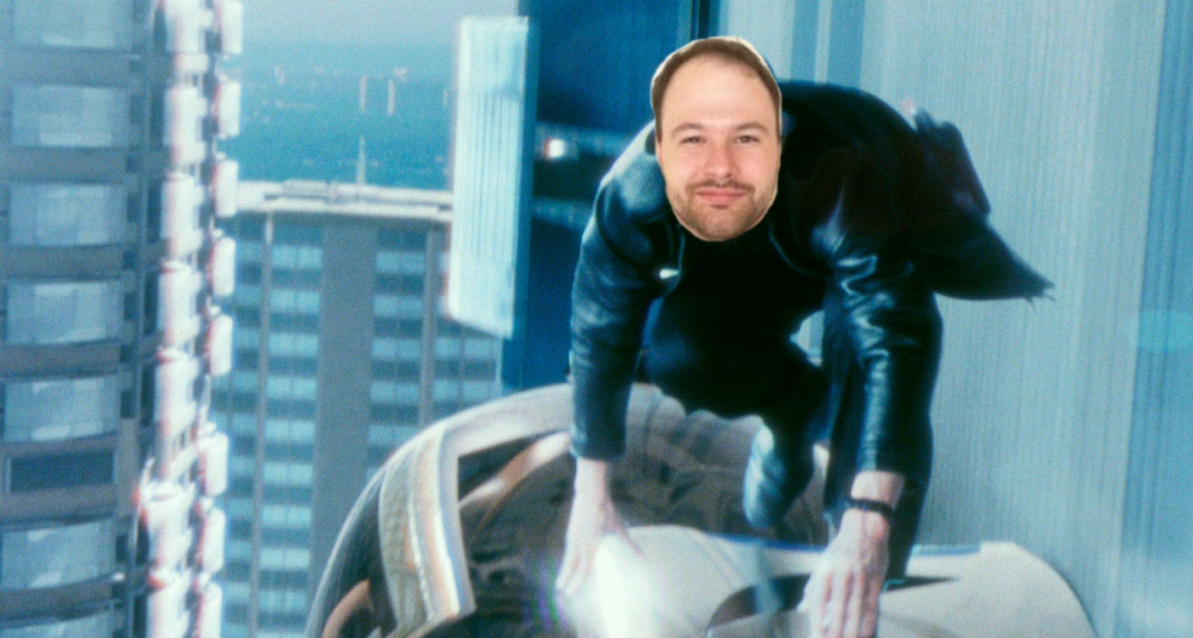
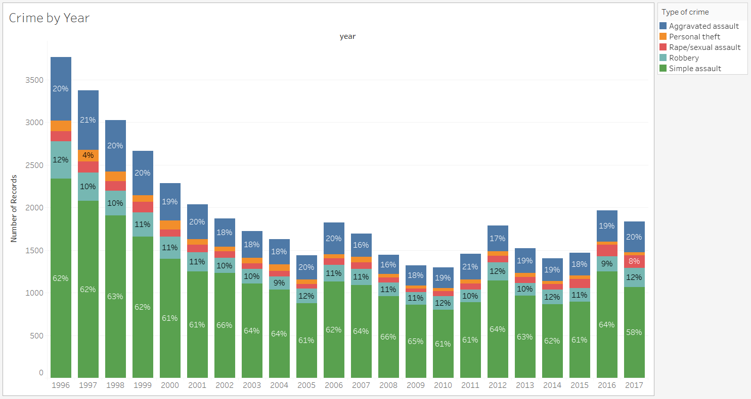
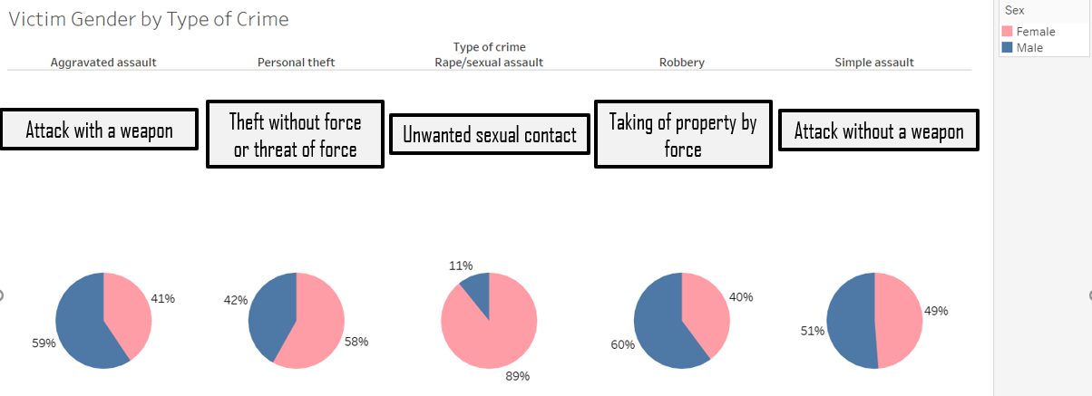
Crime appears to have decreased significantly between the late 90’s and now…yet hear I am being accused of committing a crime

Slide 9
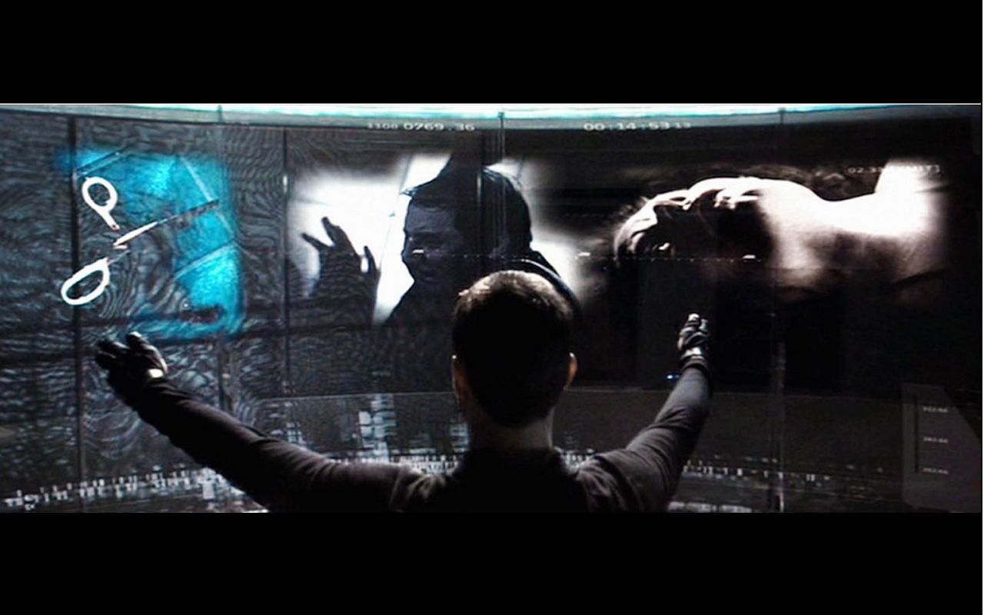
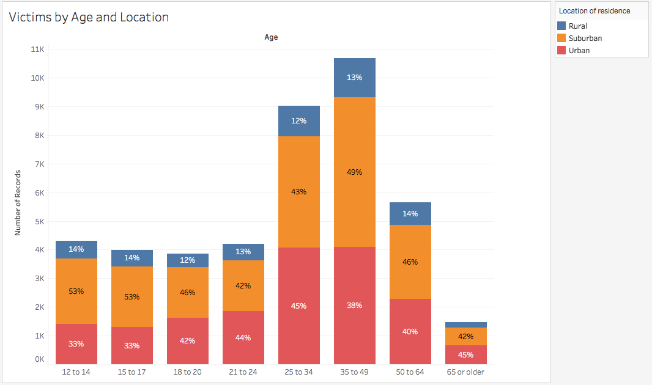
Victims of ages 25-49 are ~46% of the victimized population

Slide 10
Conclusions and Next Steps:
Limitations:
-Potential racial bias
-NCVS redesigned sampling methods in 2006
-Each record is self-reported
-Each record is a victimization not a victim
I’m just excited to have a normal life again

